Slide 1

Ruhee for Noodle Doodle by Roshni Bhattacharya
MYSQL project for a creative small business
Notes:
"Hello World! Today I’m excited to present 'Ruhee for Noodle Doodle by Roshni Bhattacharya,' focusing on how I leveraged MySQL to illuminate new pathways for creatively spirited individuals running their own businesses."

Slide 2
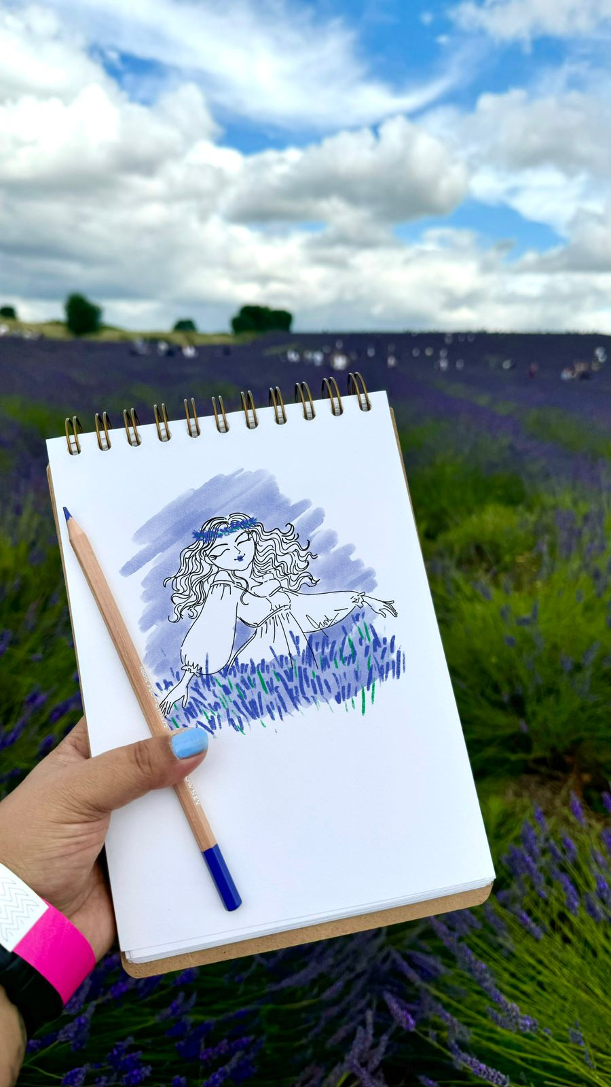

"Do you have that one friend who's creatively spirited and runs a business?"
While I’m writing the code, precise and neat,
The spirited owner’s having a creative treat. Roaming around with ideas so bright,
Turning visions to reality with pure delight.
Ruhee for NDRB
Notes:
Let’s start with a question.
Raise your hands you have that one friend who's creatively spirited and runs a business?
While I’m busy writing precise and neat MySQL code, they’re turning their bright ideas into reality. This presentation is dedicated to those creative spirits and how MySQL supports them.”
(feelings are mine, rhymed by chatGPT)

Slide 3
My first meeting understand what MySQL can do for her small business
Products & Prints
Bestselling Print
Best Selling Item
Most Profitable Item
Worst Selling
Events
How much money did I make?
Most Profitable Item
Comparing three exhibitions
Financials
How much Money did in make in a month/qtr. from all the sources?
Notes:
My goal at NDRB is to provide the support and tools needed to turn creative visions into successful businesses.
With MySQL, I efficiently manage data
to illuminate new pathways
for the creatively spirited.
So I ask her to provide me with whatever data she has.....

Slide 4

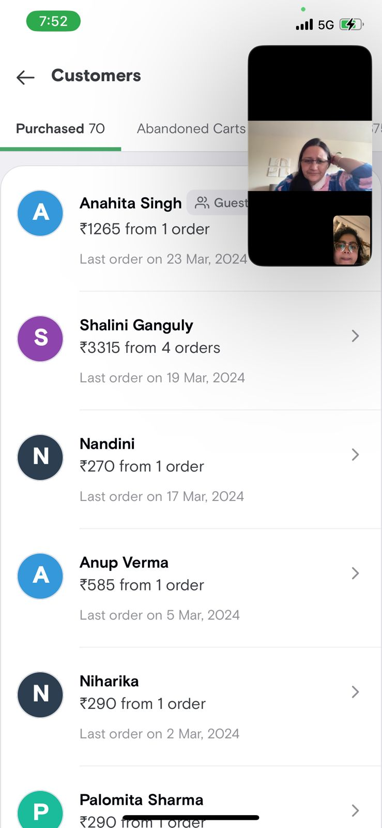
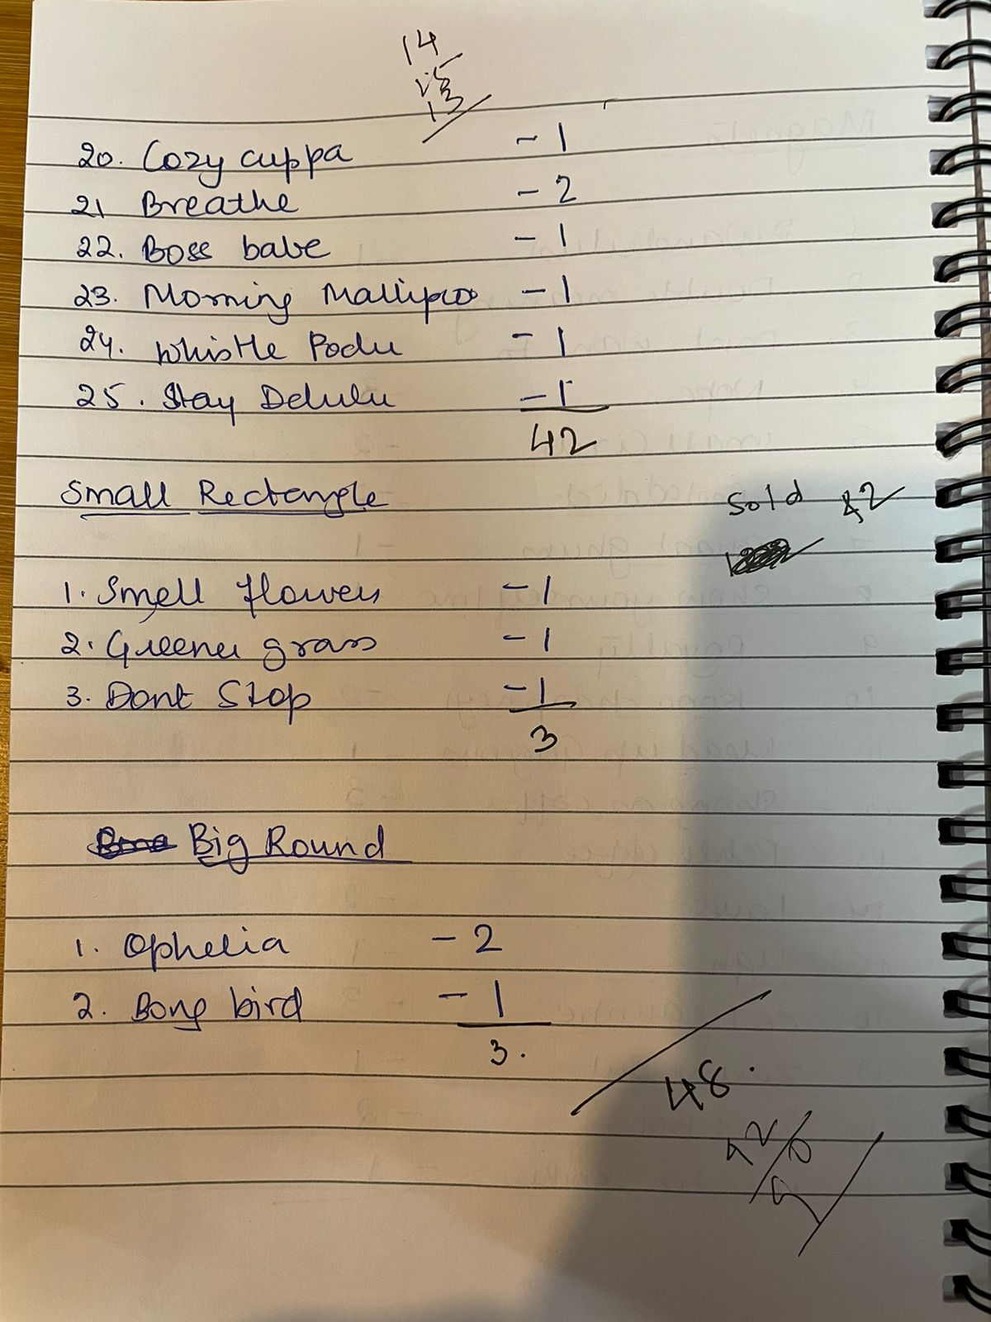
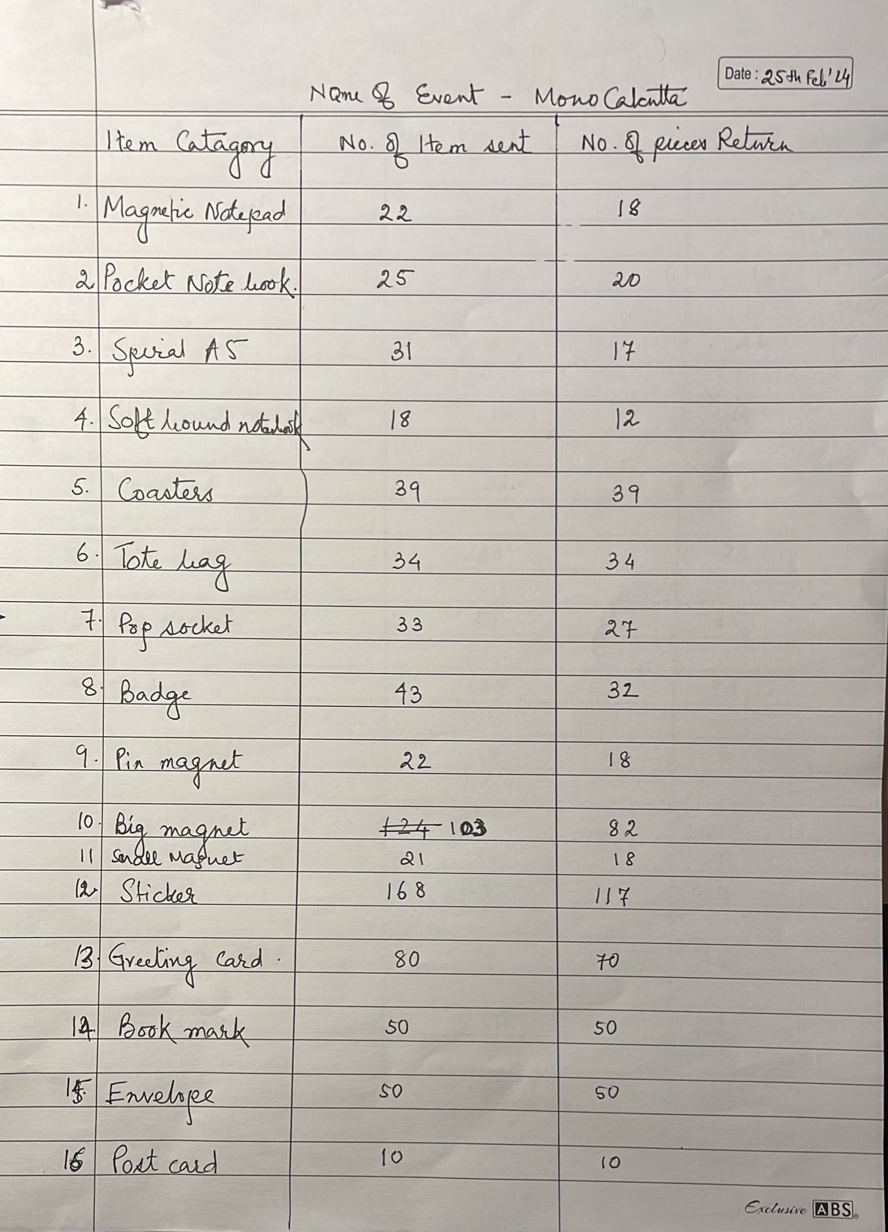
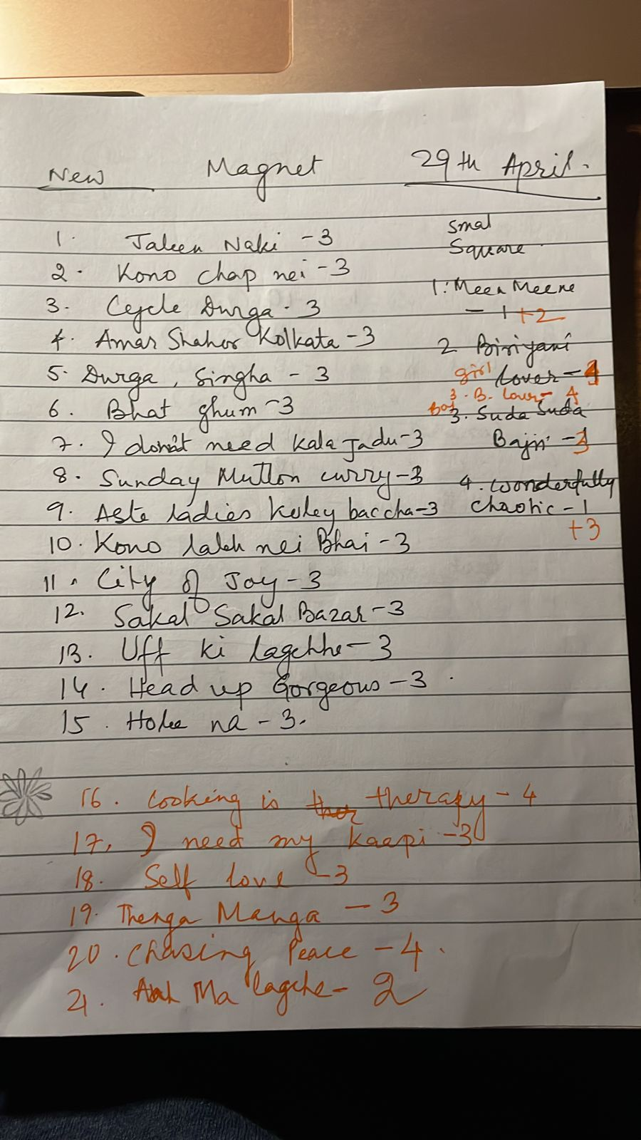
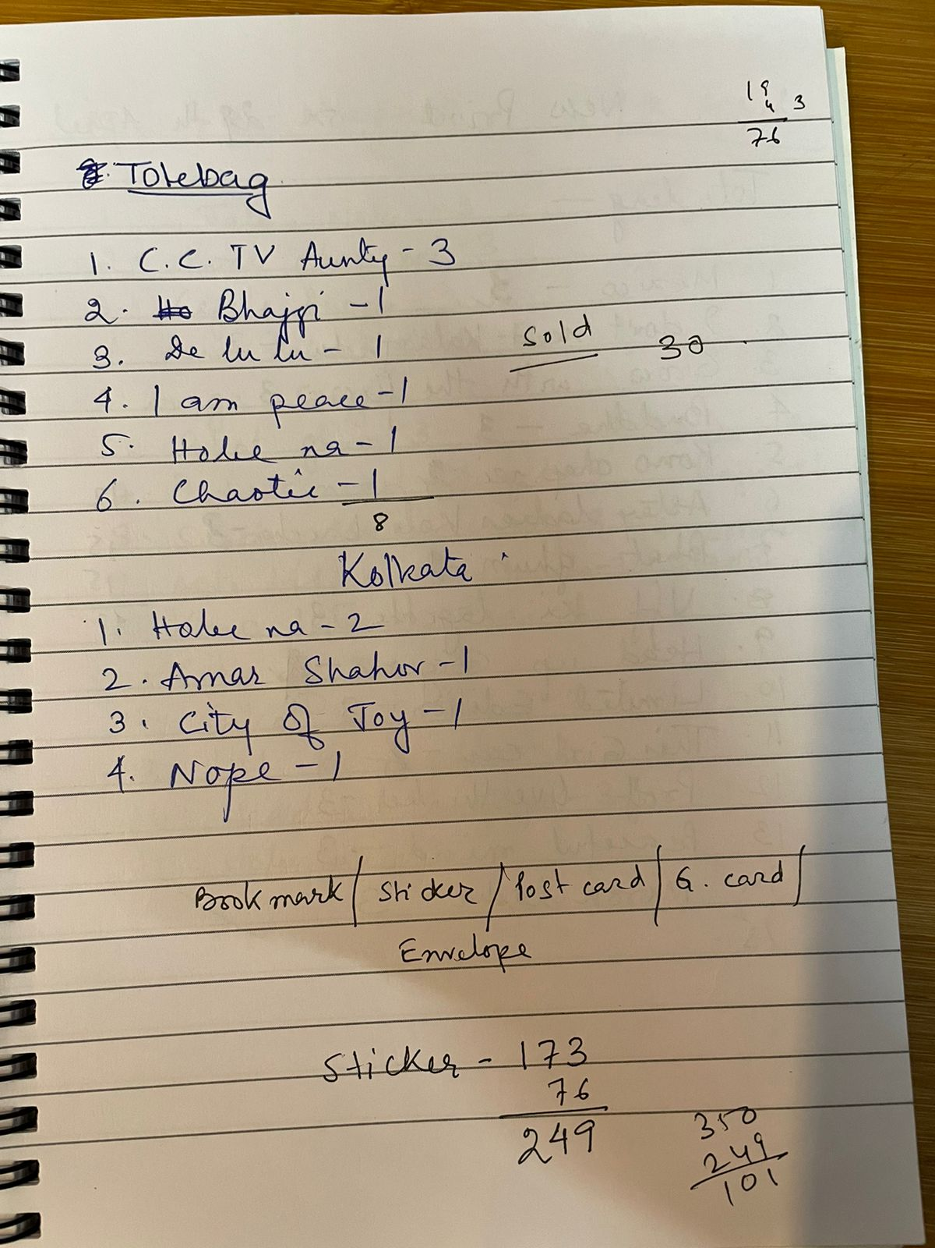
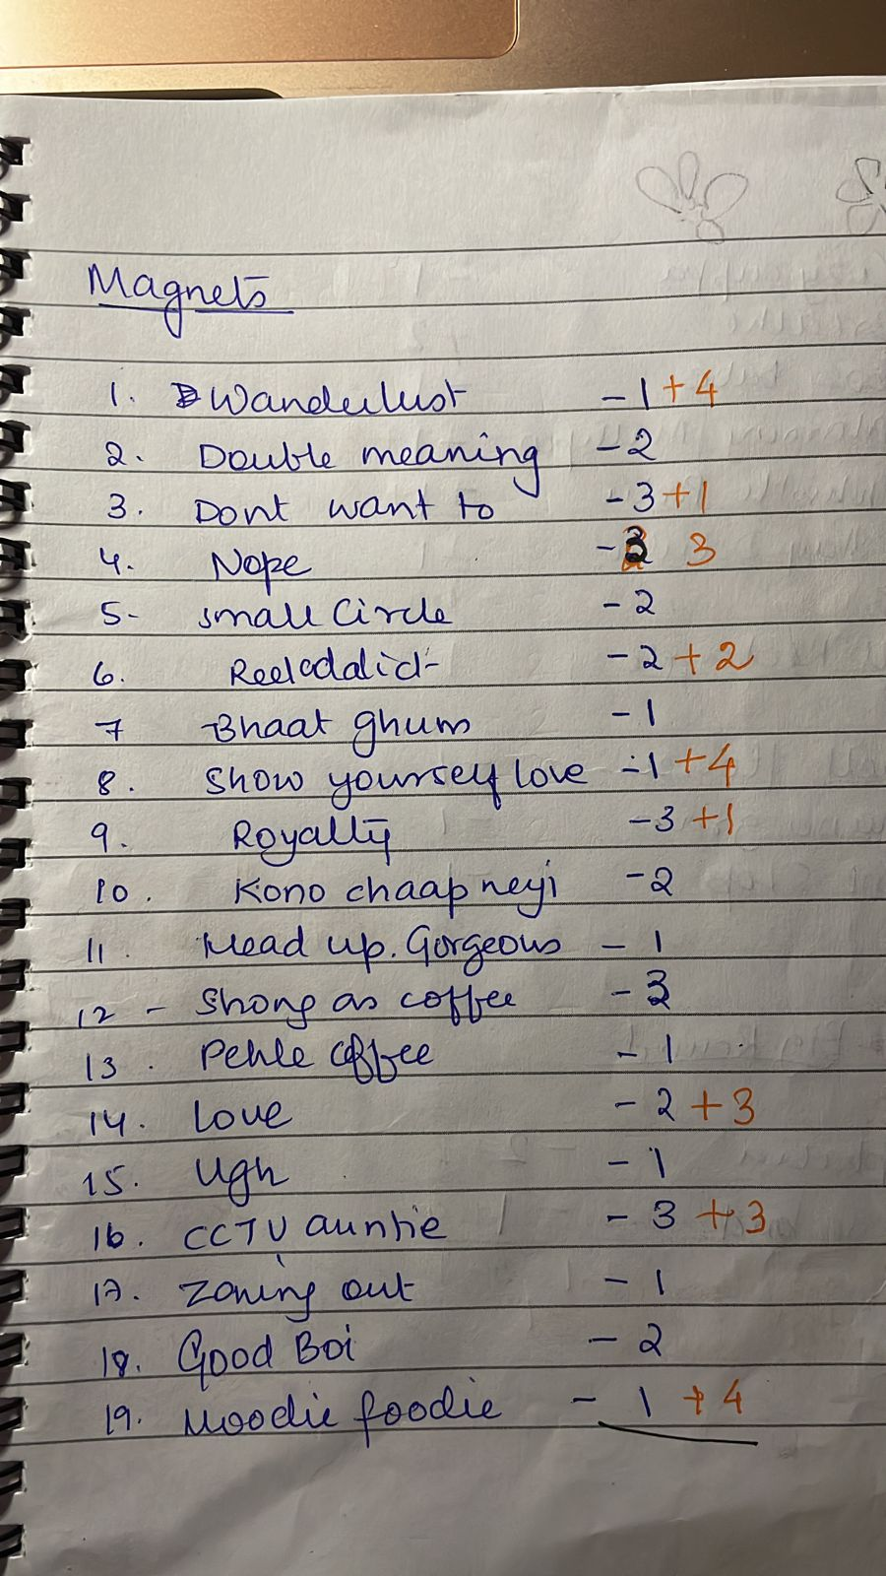
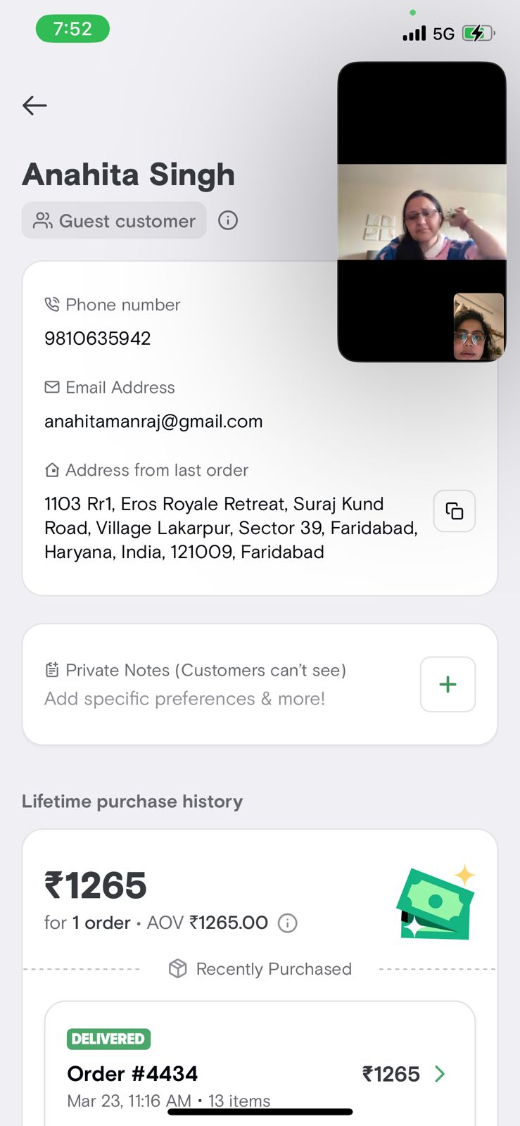
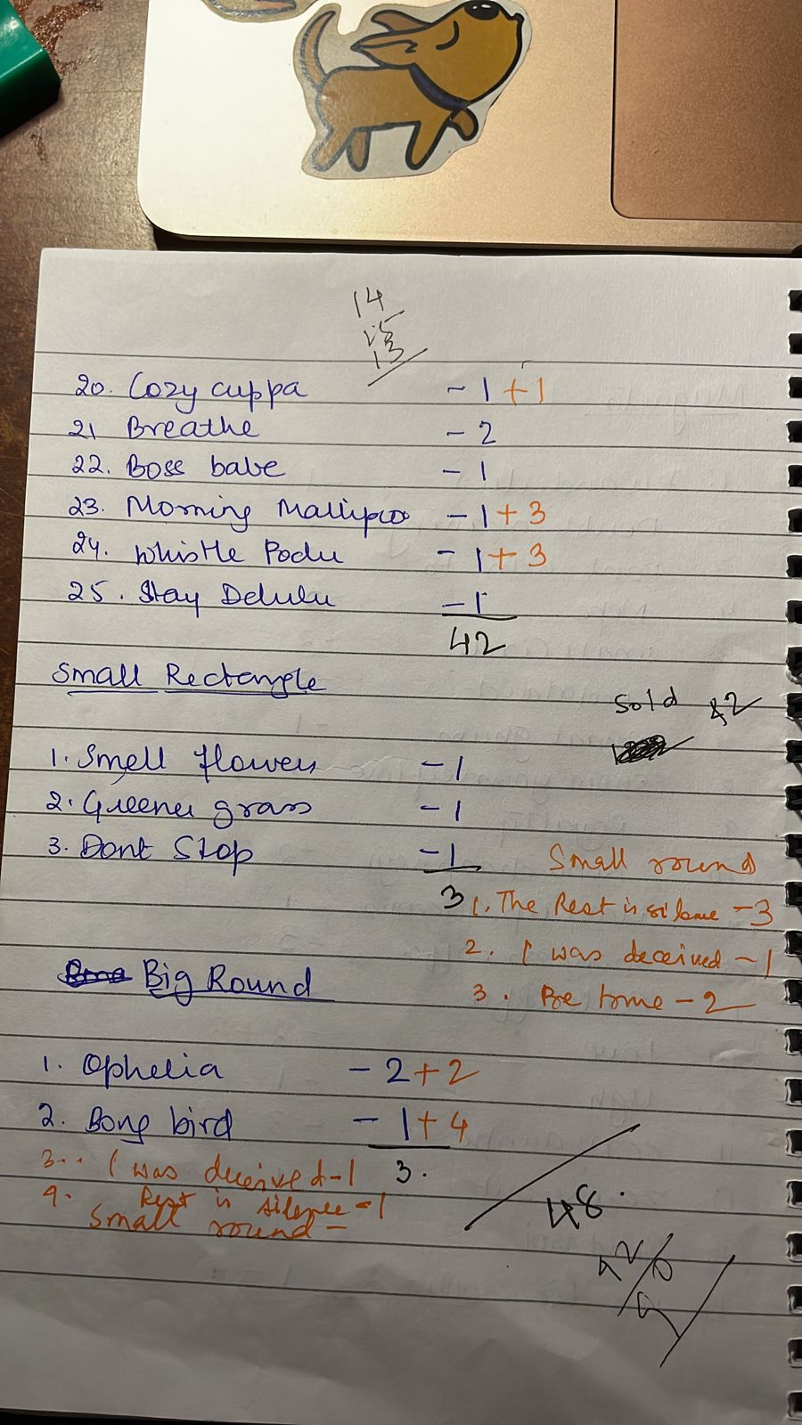
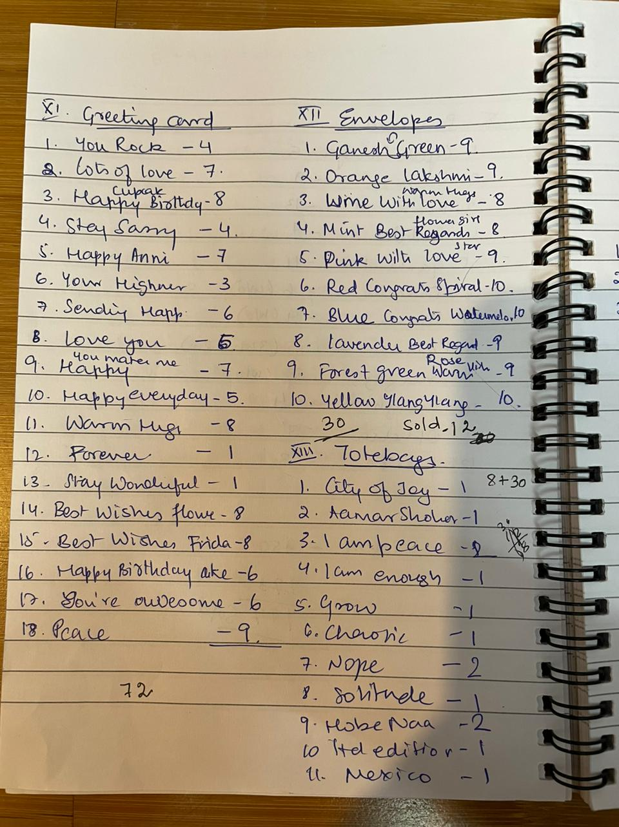
This is the data I get!

Slide 5
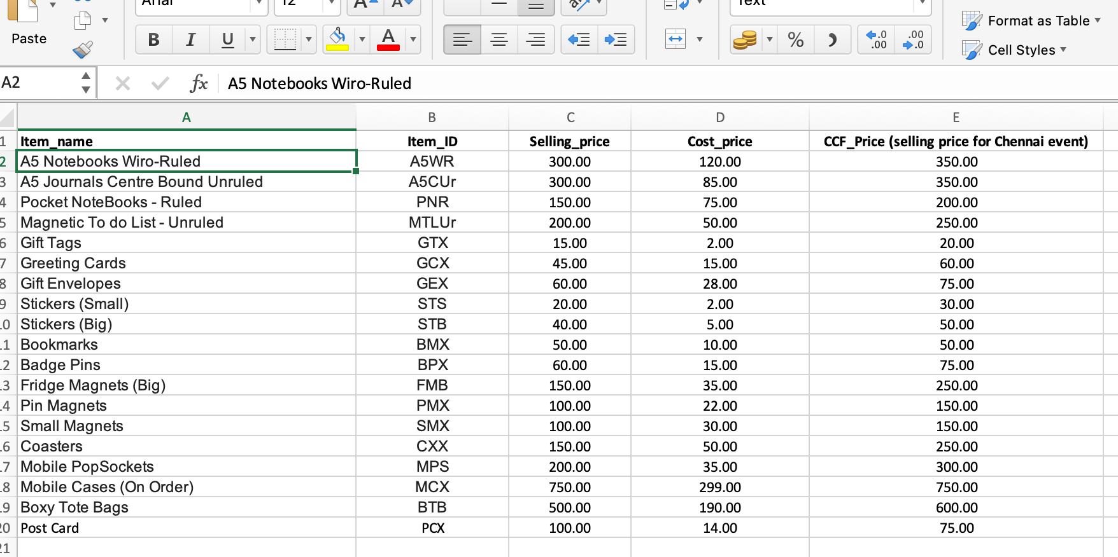
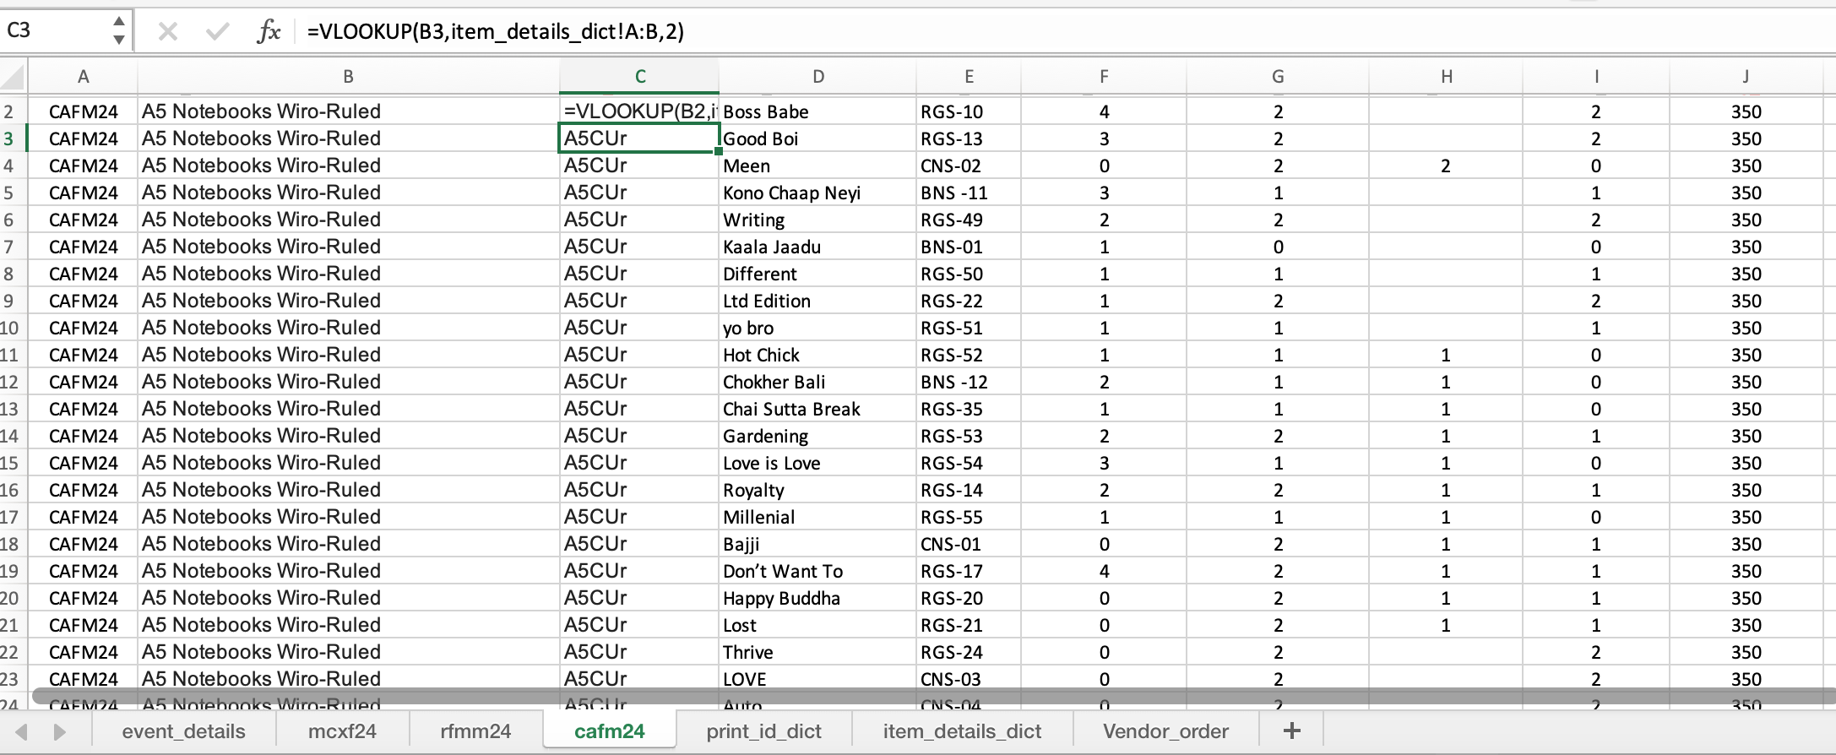

and converted to this
Notes:
Here’s how I extracted and transformed her data using Excel first.
I processed raw data into meaningful tables and sheets.
I gave item_ids, Print_ids, sale_id etc

Slide 6

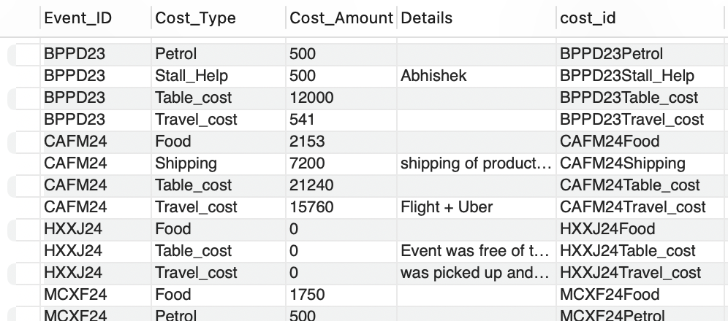
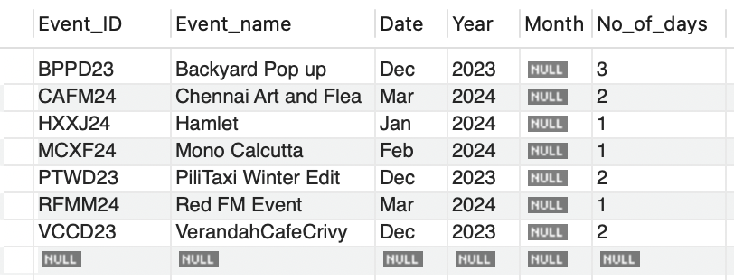
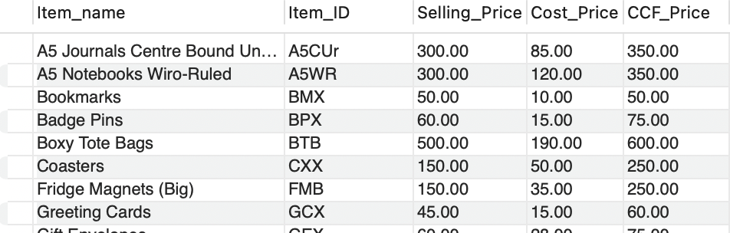
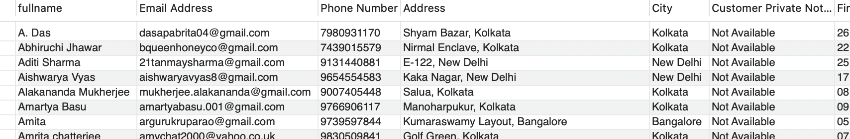
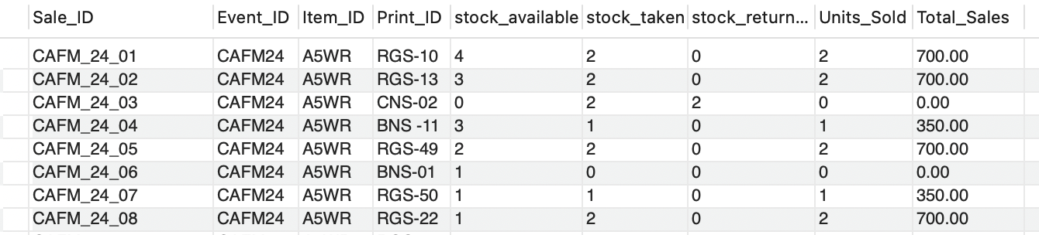
NORMALIZATION
Notes:
To ensure data accuracy and efficiency in MySQL, I applied normalisation techniques.
This process helps in organising data to reduce redundancy
and improve data integrity.
Each table now had only one parameter.
The xl files were converted to csv...
And then re-formated in ASCII in a new app called coteditor so that all this data can be imported to the workbench. Thanks to stacksoverflow!!!

Slide 7
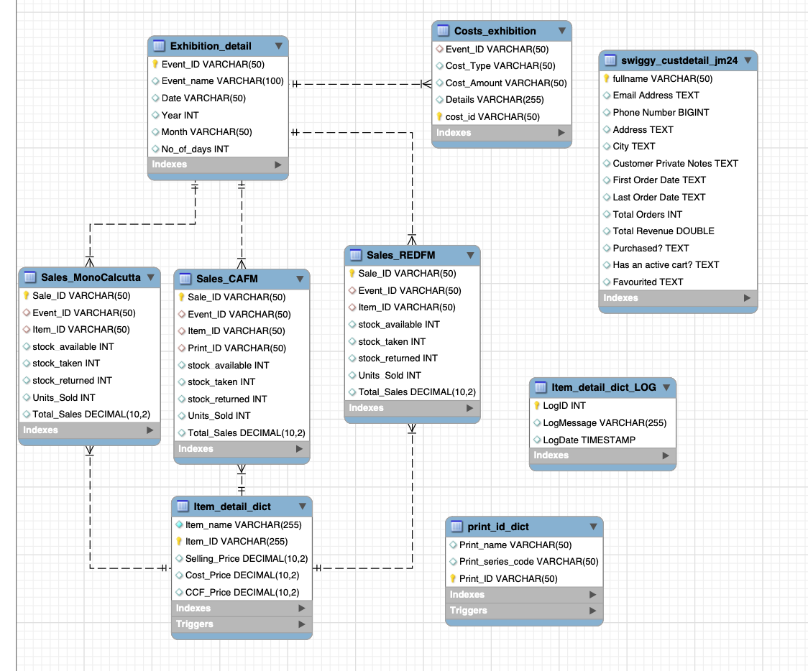
EER DIAGRAM
Notes:
Here’s the Enhanced Entity-Relationship Diagram created in MySQL Workbench. I created the PKs and FKs and I must say that the words PK and FK took another meaning for me. (PK in india means Drunk.. Ha ha! )

Slide 8
Core 1 : Using any type of the joins create a view that combines multiple tables in a logical way Join cost_exhibition & exhibition_detail to see all expenditure details related to Chennai art and flea
C1
C2
C3
C4
C5
C6
A1
A2
A3
A5
A6

Slide 9
Core 1: Using any type of the join create a view that combines multiple tables in a logical way Join ‘cost_exhibition’ & ‘exhibition_detail’ to see all expenditure details related to Chennai art and flea
C1
C2
C3
C4
C5
C6
A1
A2
A3
A5
A6

Slide 10
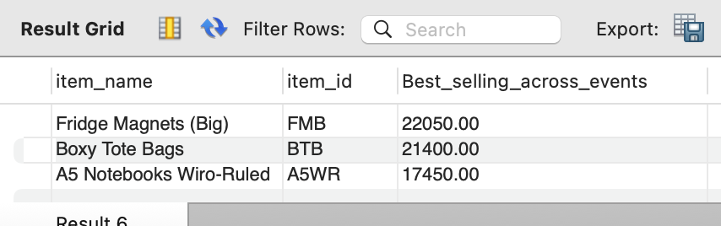
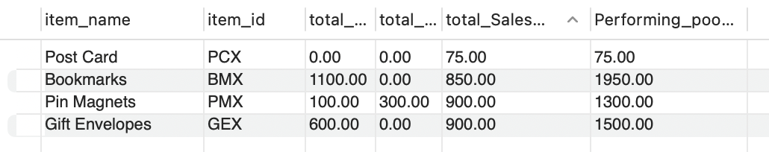
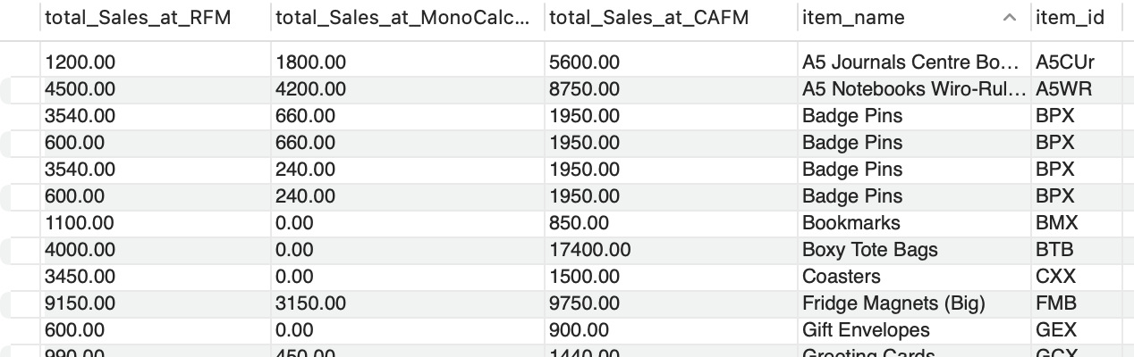
Products & Prints
Bestselling Print
Best Selling Item
Most Profitable Item
Worst Selling
Events
How much money did I make?
Most Profitable Item
Comparing three exhibitions
Notes:
I was able to dive into the product performance using MySQL data analysis. I was able to uncover the bestselling print, the best-selling item overall, the most profitable item, and also the worst-selling product. I could also explore the event performance with data fetched from MySQL. Understanding these will help her refine her strategies.

Slide 11
Special thanks to Sama and Gemma!
I would like to make a Dashboard on Power BI with this Data
No artists were harmed during the making of this project
Notes:
Thank you for your time and attention. MySQL has been a powerful tool in my project, and I’m happy to answer any questions you might have about the implementation and findings."

